Slide 1

Colony Cruiser: The Maria (Concept Fase)
Epsilon Studios

Slide 2
Voorstellen groep
Producer: Fahrettin Güngör
Lead Developer: Mack Mendes Moreira
Lead Artist: Ruben de Water
Level Designer: Lara van Hezel
User Experience: Kevin de Greef
Planningsmanager: Fahrettin Güngör
Quality Assurance: Mack Mendes Moreira

Slide 3
inhoudsopgave
GDD
Introstory
Uitleg Zones
Game Mechanics
Enemies
Creativiteit
Art Style
Backlog
Trello
UX / Leveldesign
Scripting
Doel

Slide 4
GDD overzicht
Introstory
Uitgekozen zone’s
Mechanics game
Unique aspect game
Uitleg enemies
Creativiteit en vindingrijkheid

Slide 5
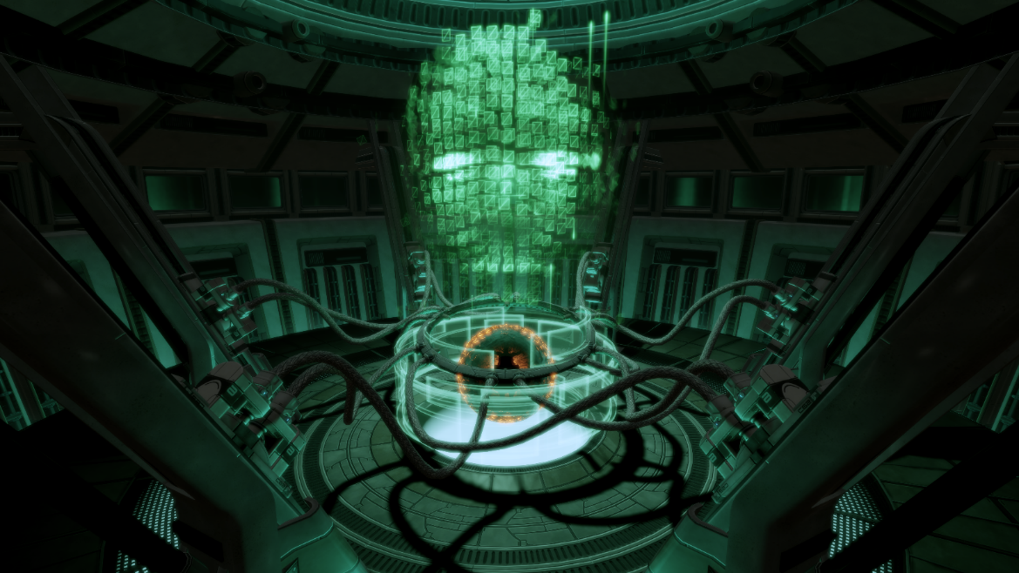
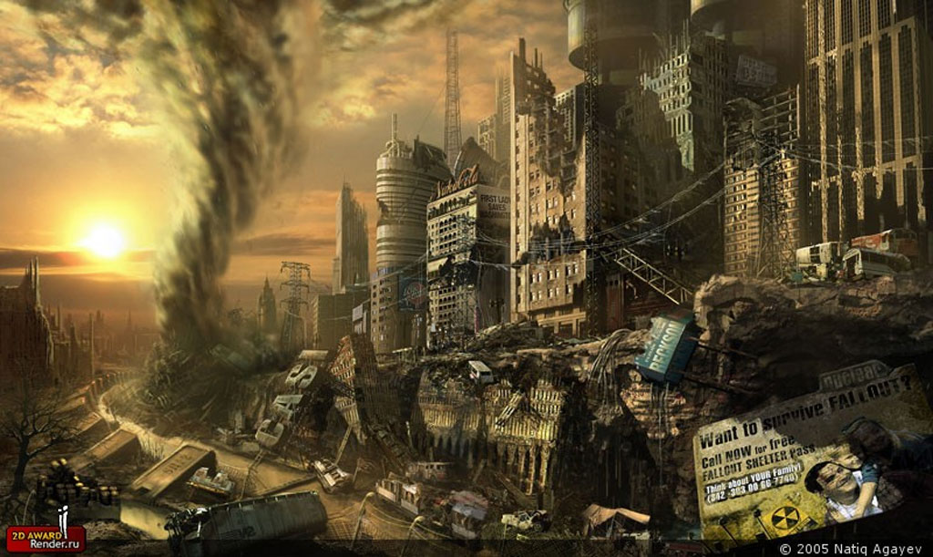
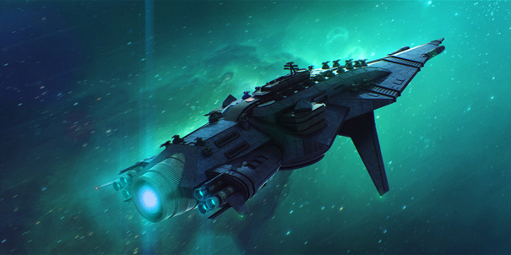
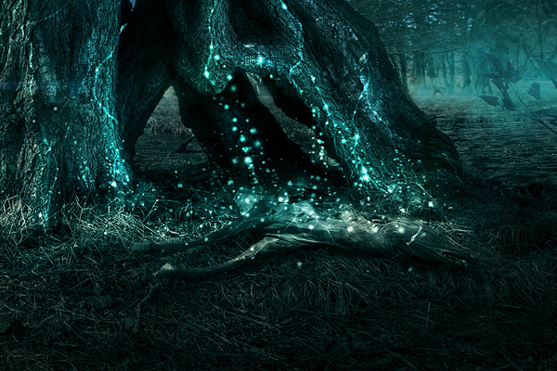
Introstory

Slide 6
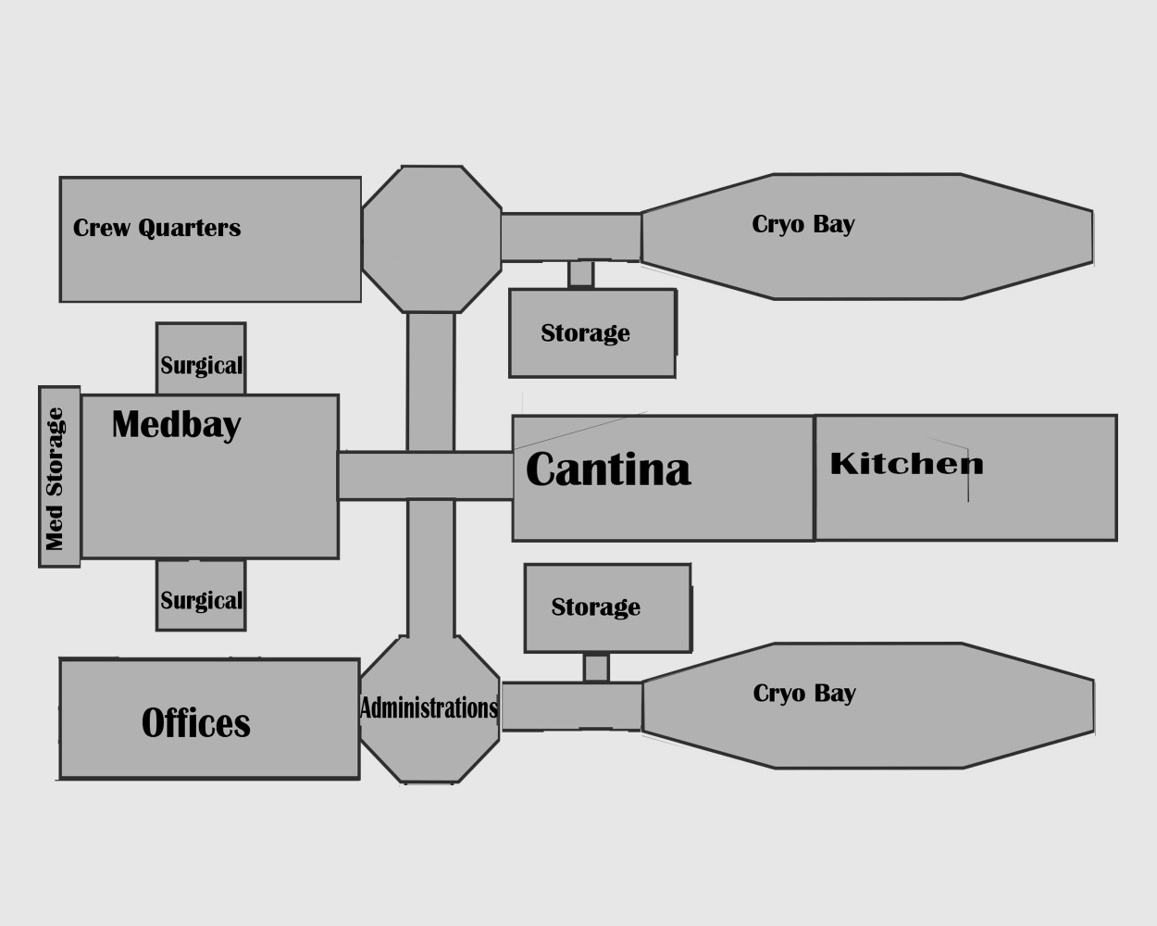
Uitleg Zones
Verdieping 2

Slide 7
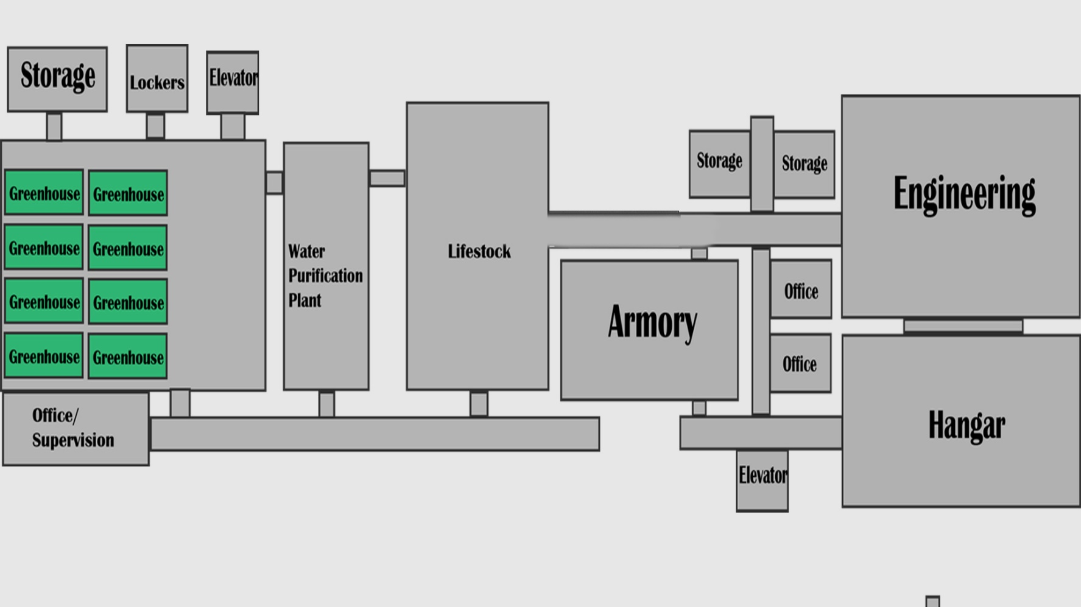
Uitleg Zones
Verdieping 1

Slide 8
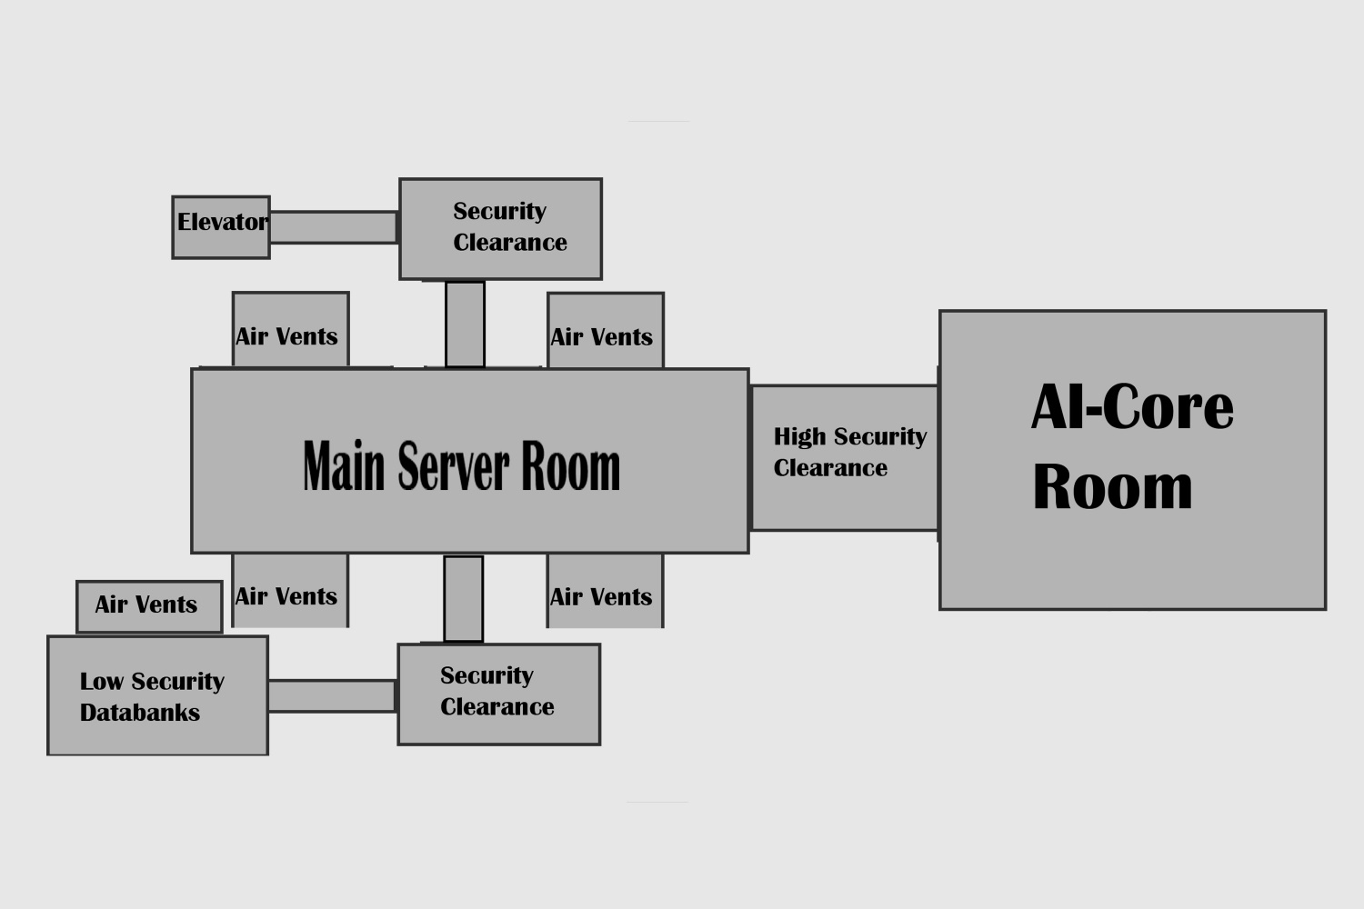
Uitleg Zones
Verdieping 0

Slide 9
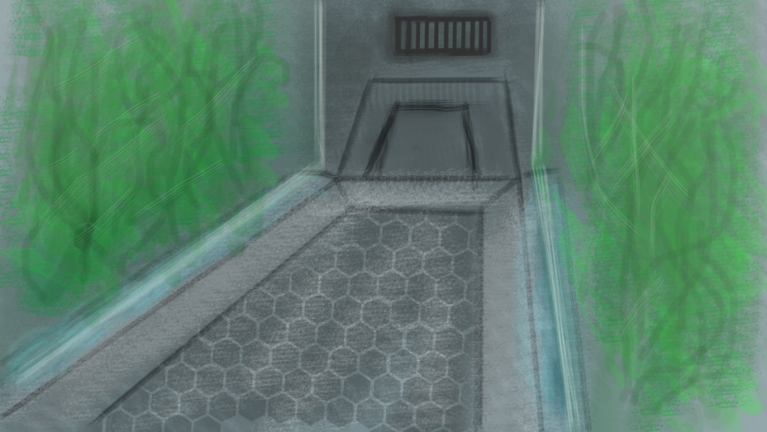
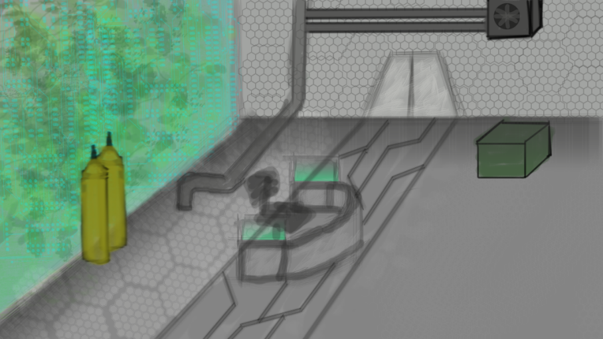
Game Mechanics
Mechanics Game
Player mechanic
Weapon mechanic
Med en stimpacks mechanic (uniek aspect)
Loot mechanic
Alarm mechanic (uniek aspect)
Enemy mechanic

Slide 10
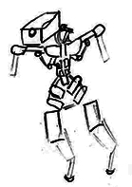
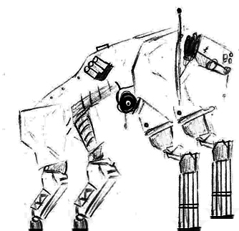
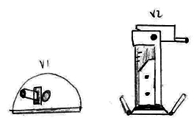
Enemies
Robots
Cameras
Proxies
Turrets
Roombas
Livestock
Mutated dogs
Mutated chickens
Special
Xenomorphic alien
Carnivorous plants

Slide 11
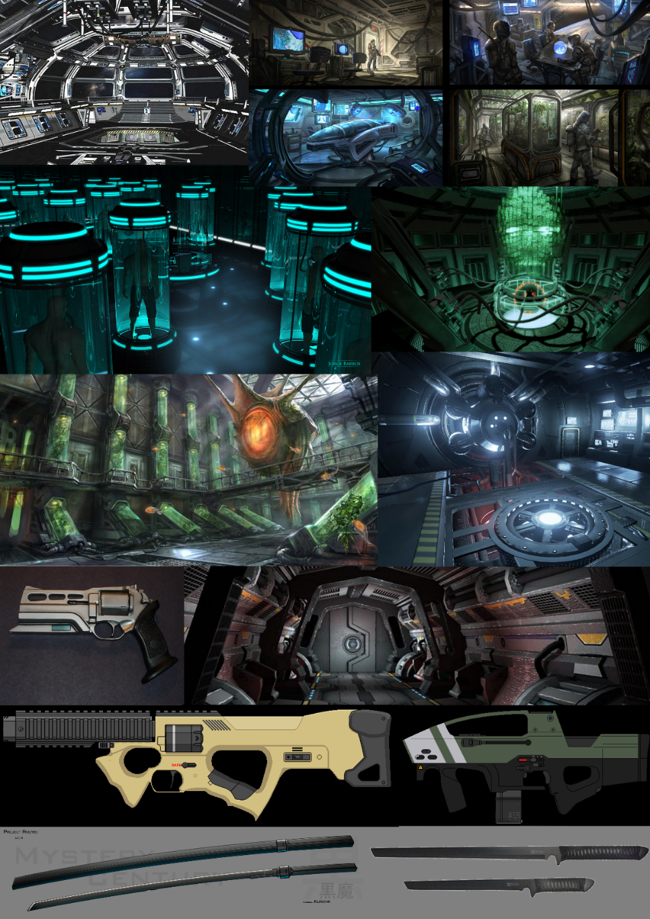
Art Style
All art
Pre-productie
PBR
Onderbouwing keuzen

Slide 12
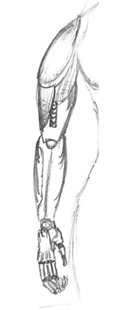
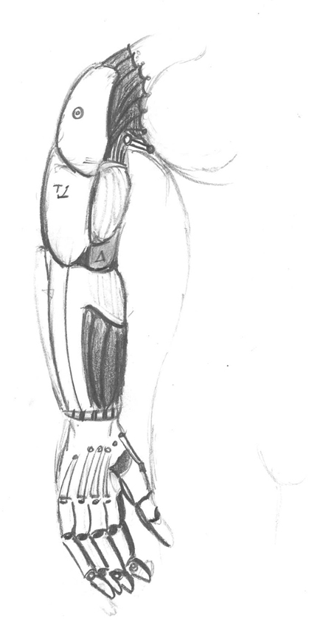
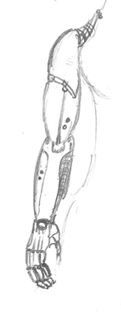
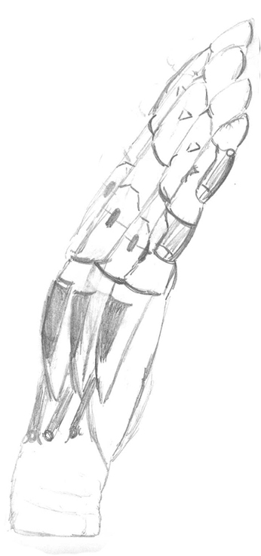
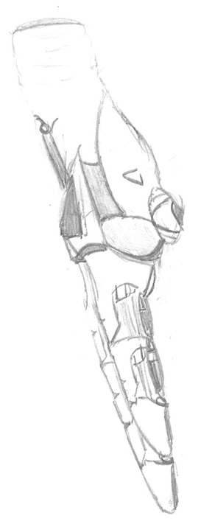
Art Style

Slide 13
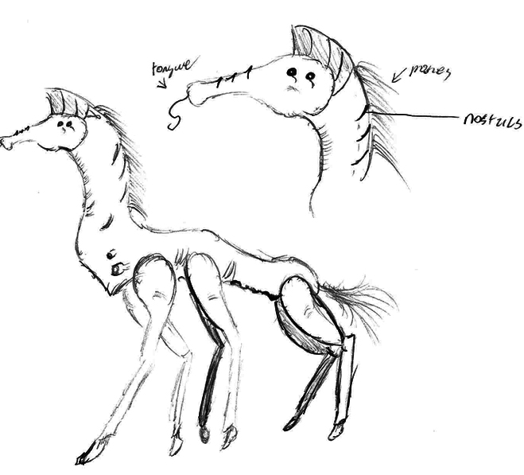
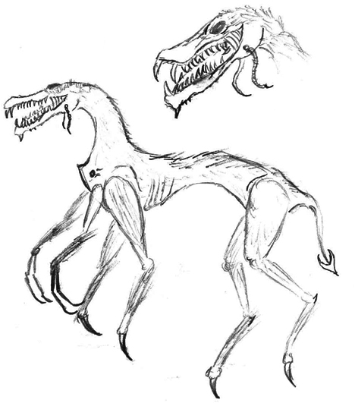
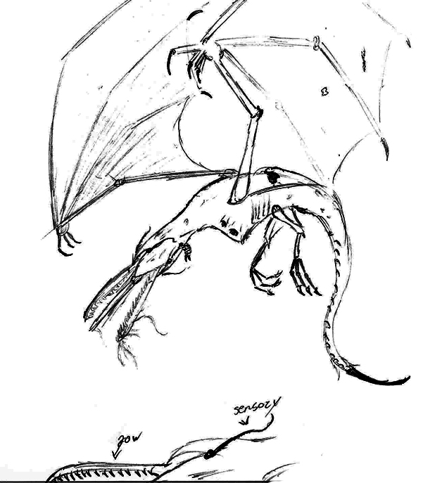
Art Style

Slide 14
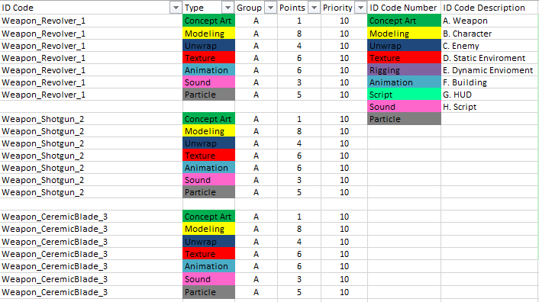
BackLog
Backlog (Asset-List)
Asset-List met puntensysteem

Slide 15
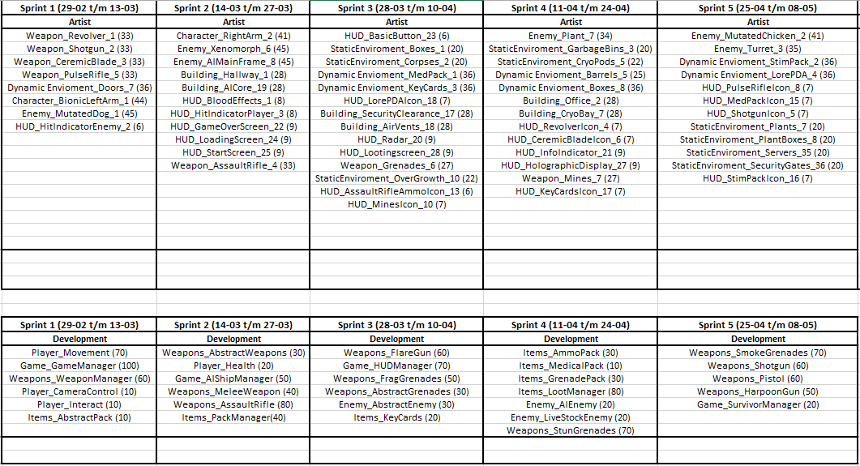
BackLog

Slide 16
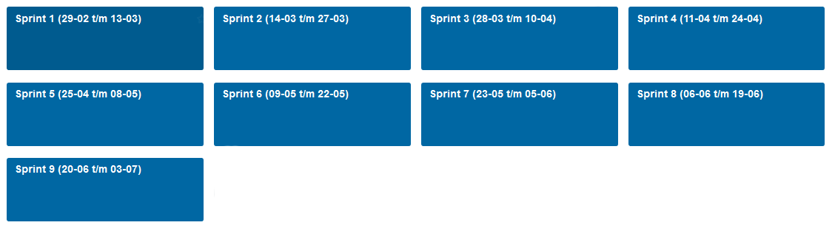
Trello
Planning in trello
Uitleg taakverdeling

Slide 17
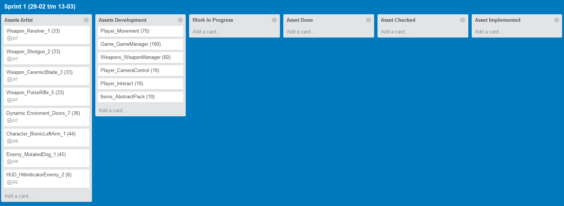
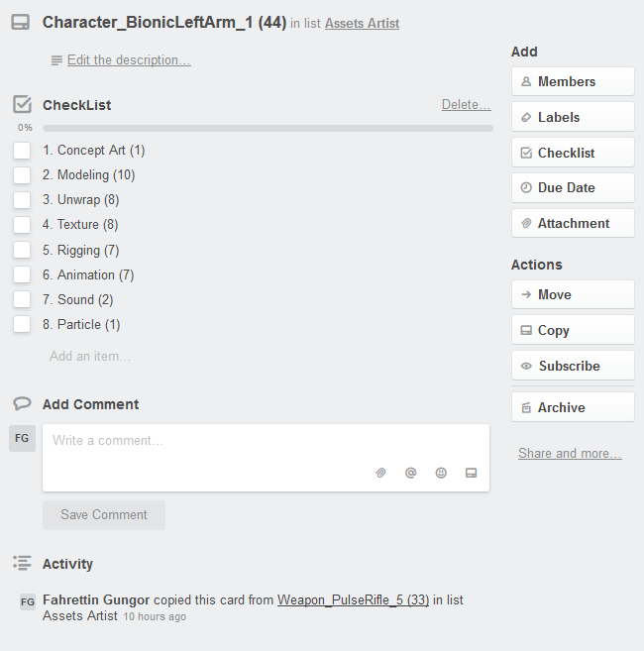
Trello

Slide 18
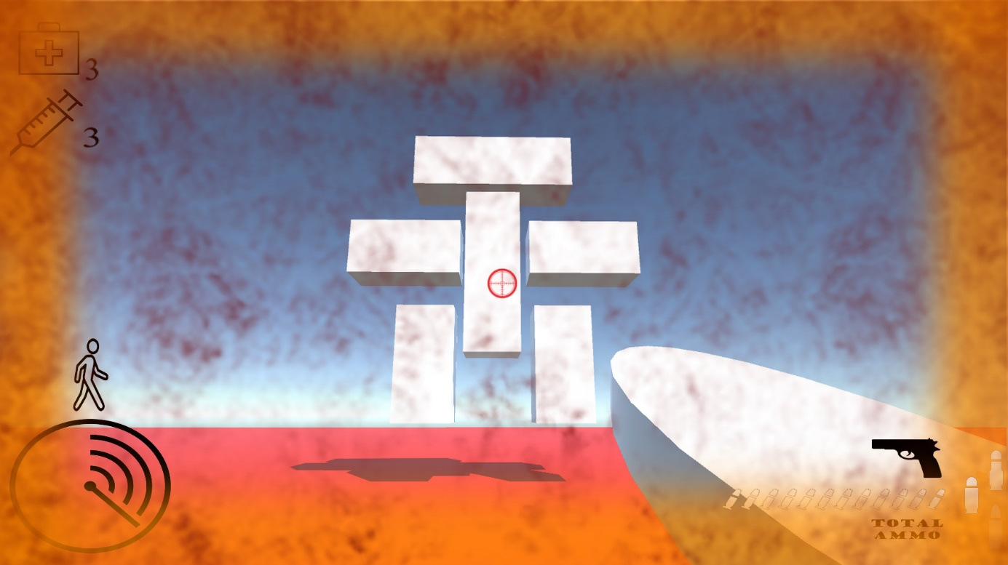
UX / Leveldesign
Puzzle
Fun to play factor
User interface
Gameflow van begin tot eind
Enemies en weapons
(Diverse Ammo, Etc.)

Slide 19
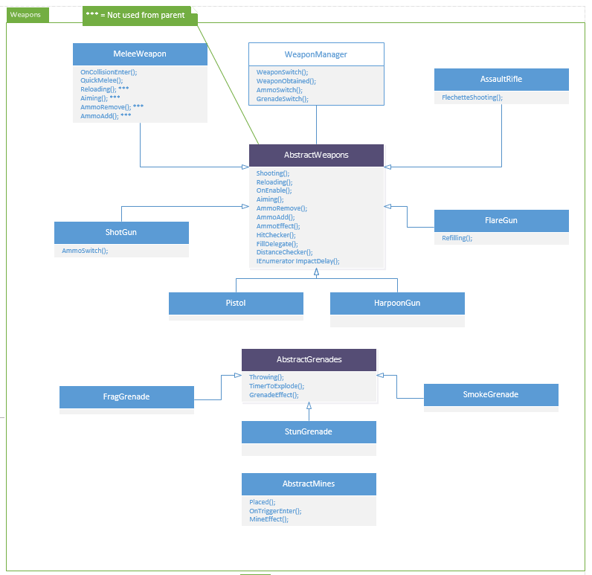
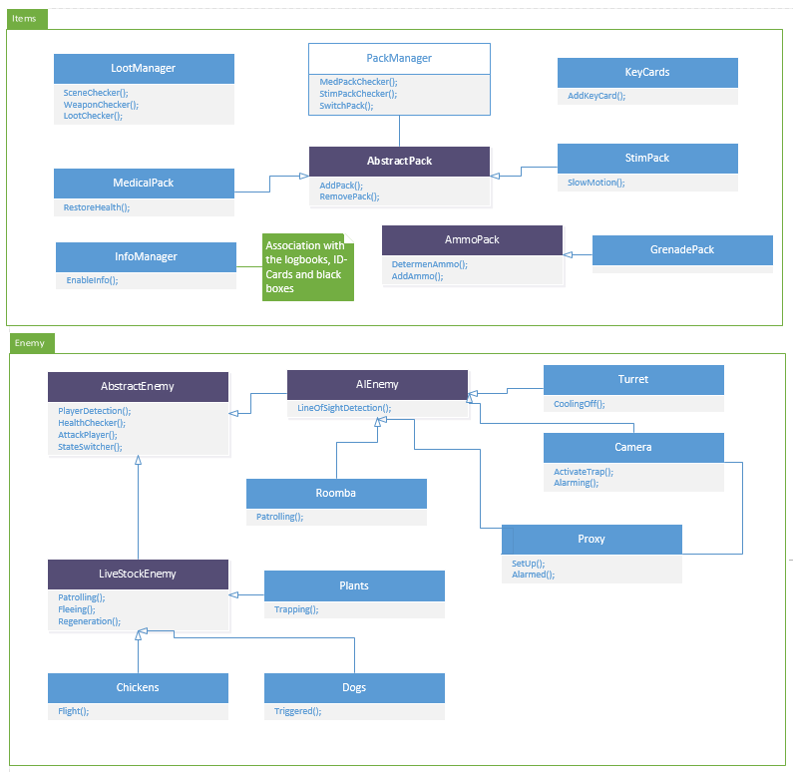
Scripting

Slide 20
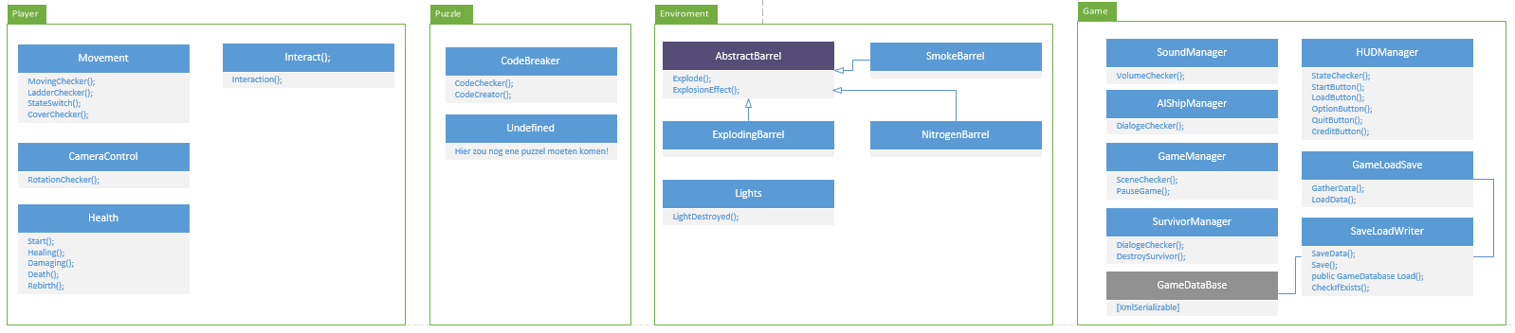
scripting

Slide 21
Doel
Einddoel
Prototype

Slide 22
Vragen ?

